Slide 1

Hirachand Nemchand College of
Commerce, Solapur
Autonomous College
Class- B.Com Part- I, Sem-I
Reading Material
Sub- Principles of Marketing

Slide 2
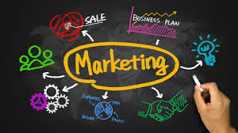
Marketing
Introduction:
History of Human Civilization
Exchange is the central theme
Need is the driving force for all types of transactions
Human wants are multiple, unlimited, innumerable, variable and recurring.
Needs are transformed in to wants
Wants generate demand
https://www.manbiz.com- Picture

Slide 3
Definitions
Kotler:
“Marketing is a human activity
directed at satisfying needs and wants
through exchange processes”.
American Marketing Association
“Marketing is the activity, set of institutions, and processes for creating, communicating, delivering, and exchanging offerings that have value for customers, clients, partners, and society at large”. (Approved 2017)

Slide 4
Nature and Scope of Marketing
Distributive Focus
Demand- Before and after the Industrial Revolution
Radical changes
Production stared in anticipation of demand.
Mass production, uniform quality
Need for extra effort was felt
Potential Market

Slide 5
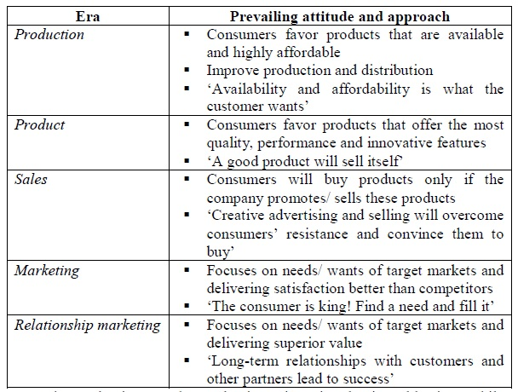

Slide 6
Nature and Scope of Marketing
In present days Marketing is thought to perform certain educative function besides economic and social function.
Scope of Marketing
It starts from making a thinking about consumption and covers different important business activities relating to production, pricing, distribution, profit making and development of organization`s goodwill.

Slide 7
Nature and Scope of Marketing
Discovering customer needs
Translating these needs in to suitable products and services
Creating demand for these products and services
Serving the consumer demand
Expanding the market.

Slide 8
Nature and Scope of Marketing
Philip Kotler explains:
Understanding, creating, communicating, and delivering customer value and satisfaction are at the very heart of Modern Marketing, thinking and practice.
Right from the conceptualization to After sales service

Slide 9
Importance of Marketing
As a Business Function
-Provides direction to selling efforts
-Creation and Retention of customers
Develops new products and new markets
Higher returns
Survival and future growth
To overcome competition

Slide 10
Importance to Economy and Society
Brings economic value to products and services
Employment
Encouragement to Enterprise
Boost to Entrepreneurship
Development of allied services
Encouragement to Investment
Speed up the process and rate of economic development.
Marketing has educative value
Marketing develops new consumption pattern

Slide 11
Meaning of Marketing Environment:
The marketing environment refers to all internal and external factors, which directly or indirectly influence the organization’s decisions related to marketing activities..

Slide 12
Internal factors are within the control of an organization; whereas, external factors do not fall within its control.
The external factors include government, technological, economical, social, and competitive forces; whereas, organization’s strengths, weaknesses, and competencies form the part of internal factors.
Marketers try to predict the changes, which might take place in future, by monitoring the marketing environment. These changes may create threats and opportunities for the business. With these changes, marketers continue to modify their strategies and plans

Slide 13
A marketing environment mostly comprises of the following types of environment:
1. Micro Environment
2. Macro Environment

Slide 14
1. Micro Environment: Micro environment refers to the environment, which is closely linked to the organization, and directly affects organizational activities.
It can be divided into supply side and demand side environment. Supply side environment includes the suppliers, marketing intermediaries, and competitors who offer raw materials or supply products. On the other hand, demand side environment includes customers who consume products.

Slide 15
Micro Environment
Suppliers
Marketing Intermediaries
Customers
Competitors

Slide 16
Macro Environment
Macro environment involves a set of environmental factors that is beyond the control of an organization. These factors influence the organizational activities to a significant extent. Macro environment is subject to constant change. The changes in macro environment bring opportunities and threats in an organization.

Slide 17
Macro Environment
Demographic Environment
Economic Environment
Natural Environment
Socio-Cultural Environment
Technological Environment

Slide 18
Market segmentation
Market segmentation is one of the most efficient tools for marketers to cater to their target group. It makes it easier for them to personalize their campaigns, focus on what’s necessary, and group similar consumers to target them in an effective manner.

Slide 19
What Is Market Segmentation?
Market segmentation is a process of dividing the market of potential customers into smaller and more defined segments on the basis of certain shared characteristics like demographics, interests, needs, or location.
The member of these groups share similar characteristics and usually have one or more than one aspect common among them which makes it easier for the marketer to craft marketing communication messages for the entire group.

Slide 20
There are many reasons as to why market segmentation is done. One of the major reasons marketers segment market is because they can create a custom marketing mix for each segment and cater them accordingly.

Slide 21
Importance Of Market Segmentation
Companies often deal with customers who belong to different age groups, have varied interests, and are motivated by different triggers.
Segmenting these potential customers into different groups – Makes it easier for the marketer to develop a different marketing mix for each customer segment which is more likely to bring results.
Increases the results of the marketing efforts as each of the groups witness personalized marketing messages according to what stimulates them to do the task.

Slide 22
Bases of Market Segmentation
Bases Of Market Segmentation Segmenting is dividing a group into subgroups according to some set bases.
These bases range from age, gender, etc. to psychographic factors like attitude, interest, values, etc
Gender
Age Group
Income
Place
Occupation
Usage
Lifestyle

Slide 23
Types Of Market Segmentation
Geographic Segmentation
Demographic Segmentation
Behavioural Segmentation
Psychographic Segmentation
Nature of A Market Segment

Slide 24
Benefits Of Market Segmentation
Segmenting the market offers the following benefits to the businesses – Better Matching Of Customer Needs: Different customers have different needs. By segmenting the target market and developing homogeneous groups, it becomes easier for the marketer to cater to the customer needs better.
Identification Of Gaps In The Market: Market segmentation also results in the identification of target groups that are not targeted well in the market. This opens up opportunities for the business to exploit and make profits from.

Slide 25
Benefits Of Market Segmentation
Increased ROI: Since market segmentation helps serve the customer needs better, it not only decreases spending unnecessarily but it increases repeated sales, and customers also return the favour in the form of referrals, word of mouth, etc.
Customer Retention: Customers retain with a business which understands their needs and fulfils them as they require. Segmentation helps in this.
Increased Market Share: Through market segmentation and targeted communication, a competitive advantage can be built which results in increased market share.

Slide 26
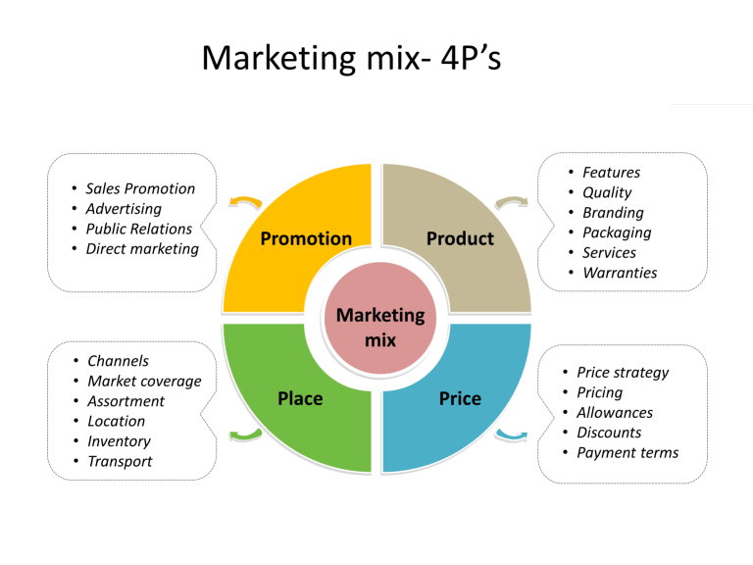
Source: https://indiafreenotes.com/4ps-of-marketing/

Slide 27
Packaging –Features
Good Presentation
Protection –goods
Safety
Advertisement
Attract customers
Increase durability
Ingredients
Manufacture and Expiry Date
Branding
Design
Distribution (Transport)
Differentiation
Communication with Customer
How to use the products

Slide 28
Product Life Cycle
Every product has a definite life and in business through the various stages of the product life cycle. So we measure its performance and success rate in the market.
Basically in which it would show different levels of sales and profit.

Slide 29
Stages of Product Life Cycle
Product Development
Introduction
Growth
Maturity
Decline

Slide 30
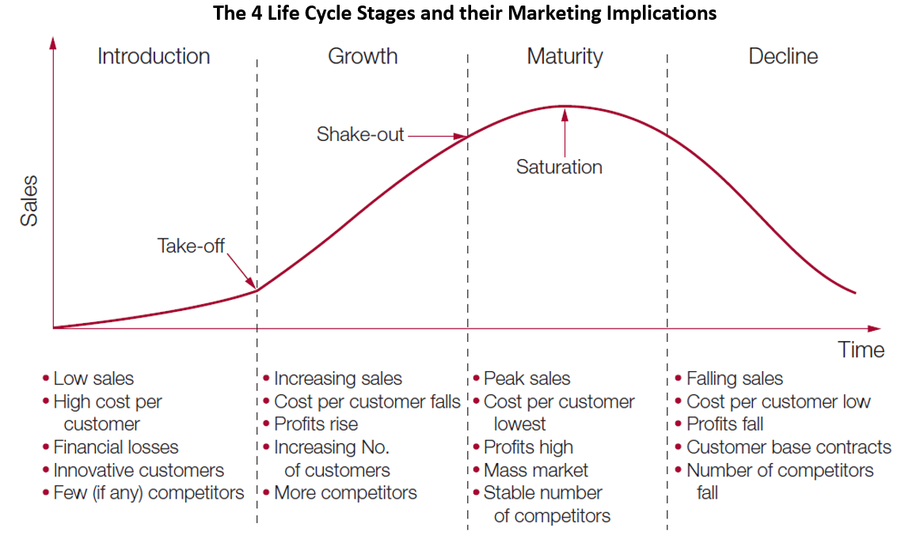
Source: https://www.pinterest.co.uk/pin/525584219014795391/

Slide 31
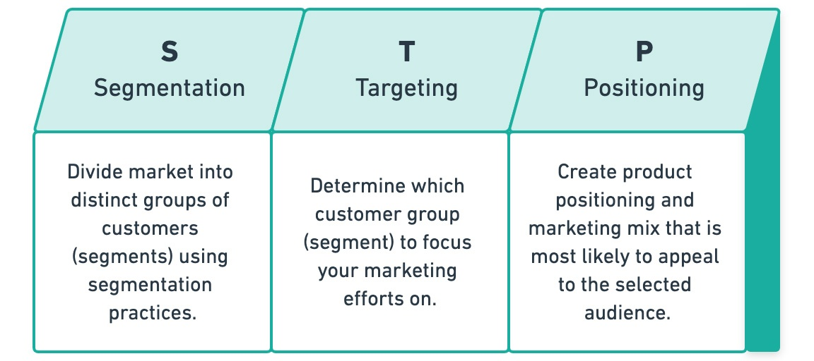
Source:https://www.yieldify.com/blog/stp-marketing-model/

Slide 32
Green Marketing
Green marketing involves companies promoting their products or services in a way that showcases their eco-friendliness.
Alternate name: Eco-marketing, environmental marketing
When a company showcases its eco-friendliness, that may include products:
Manufactured in a sustainable fashion
Not containing toxic materials or ozone-depleting substances
Produced from recycled materials or able to be recycled
Made from renewable materials
Not making use of excessive packaging
Designed to be repairable and not thrown away

Slide 33
Green Marketing
Consumers who prefer to purchase green products even though they might be more expensive fall into the ‘LOHAS’ category. LOHAS stands for Lifestyles of Health and Sustainability. According to Wikipedia:
“LOHAS describes an integrated, rapidly growing market for goods and services that appeal to consumers whose sense of environmental and social responsibility influences their purchase decisions.”

Slide 34
Thank you

